Slide 1

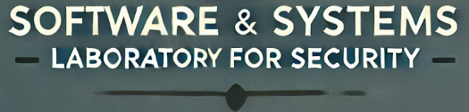

Weekly Progress: Naver API and Voice Input
On Development of an on-Premise AI Product Recommendation Model Using Open-Source LLM
Atique Md Monir Ahammod Bin (248810) 28 May 2025
Department of Artificial Intelligence Convergence

Slide 2

Project Description
Project Title
Development of an on-Premise AI Product Recommendation Model Using Open-Source LLM
Company: Narosu Co. Ltd.
Project Description
The e-commerce market is becoming increasingly competitive, requiring advanced recommendation systems.
Large marketplaces use sophisticated AI models, but independent online store operators lack such solutions.
This project aims to develop an AI-powered product recommendation system tailored for self-managed online stores.
By analyzing customer preferences, the system will suggest products that align with their interests.
Project Objective
Develop an AI-based search and recommendation system that analyzes user input sentences and recommends the TOP 5 most relevant products based on semantic similarity.
Utilize Natural Language Processing (NLP) and vector search technology to provide a highly refined search experience.
Deploy in an on-premise environment to ensure data privacy and full control over the recommendation process.
1

Slide 3

Company Requirements
Company Requirements:
2

Slide 4
Selected Technology Stack
Selected Model and Vector Store:
Component | Technology Used | Description
LLM (Large Language Model) | LLaMA 3.1 8B instant | Performs reasoning and generates responses based on user input and context
LangChain (LLM Framework) | LangChain | Connects LLMs to external tools and vector databases for enhanced reasoning and document access
Embedding Model | OpenAI text-embedding-ada-002 | Converts text into dense vector representations using semantic similarity
Vector DB / Search | Qdrant | High-dimensional vector indexing with cosine similarity, metadata filtering, and hybrid search
Vector Search Library | Qdrant (built-in) | Optimized internal search within Qdrant; no separate library like FAISS needed
RAG (Retrieval-Augmented Generation) | LangChain + Qdrant + LLM | Retrieves semantically relevant documents from Qdrant to support LLM-generated answers
API Architecture | Gradio + FastAPI | Gradio handles UI and function binding; FastAPI supports additional backend API endpoints
GUI (Graphical User Interface) | Gradio | Provides interactive chatbot interface with support for image display and recommendation output
3

Slide 5


Requirements Fulfillment Summary - ✅ 100% Fulfilled
Company Requirement Alignment
️LLM Setup (LLaMA 3.1 8B Instant)
️LangChain Integration
️OpenAI Embedding + Vector DB (Qdrant)
️Vector Search & RAG Implementation
️API Development (FastAPI + Gradio)
️Chatbot GUI with Image Display
️Recommendation Logic (OwnerClan 3 + Naver 2)
️Fallback logic for alternative recommendations
️Response Time Optimization (≤ 5s)
Flexible model/embedding model architecture
Mutiple languages support
Modifiable attribute fields (title, code, origin, etc.)
️
Extra Features:
Login/ Register Option
Mutiple Users Management
Chat History Option
Voice Input
Dedicated Naver Product Search Button
Evaluation Dashboard
4

Slide 6
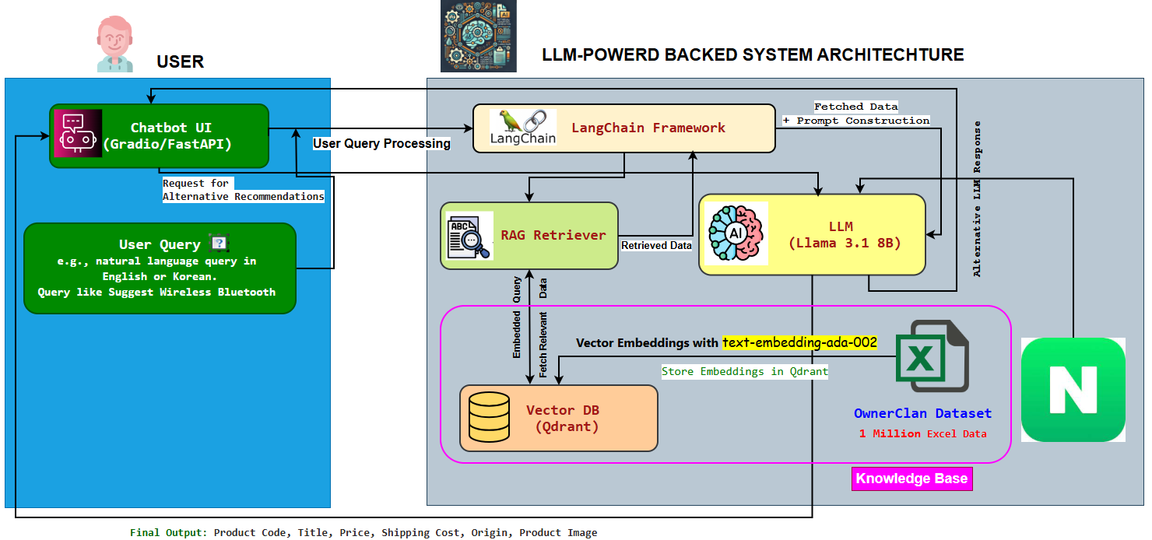
Updated System Configuration (AI Model) Diagram
5

Slide 7
Project Schedule (Gantt Chart)
Phase | 2025
 | March |  |  |  | April |  |  |  | May |  |  |  | June
 | 1 | 2 | 3 | 4 | 1 | 2 | 3 | 4 | 1 | 2 | 3 | 4 | 1 | 2
Project Understanding and Data Collection
Data Analysis and Pre-processing
Model Selection and Training
System (RAG) Development
Chatbot Development
Testing and Deployment
6

Slide 8
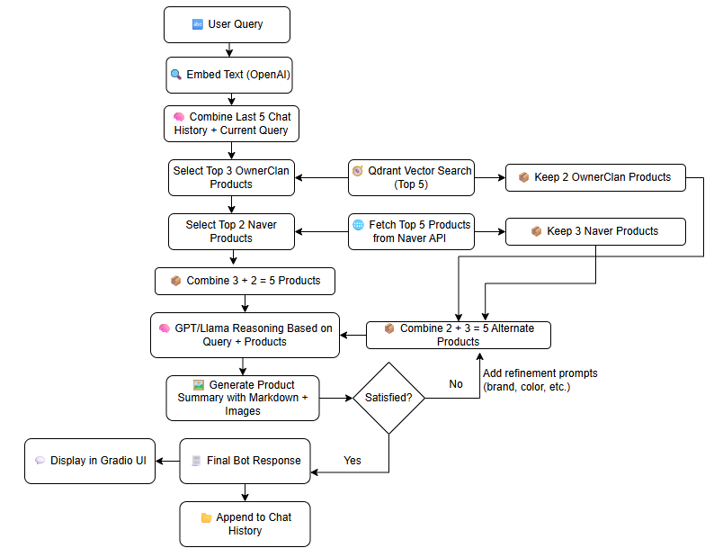
Chatbot Working Pipeline
7

Slide 9
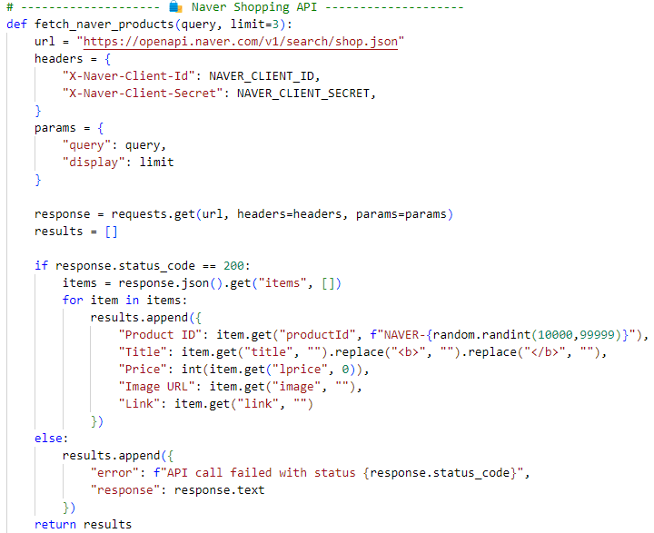
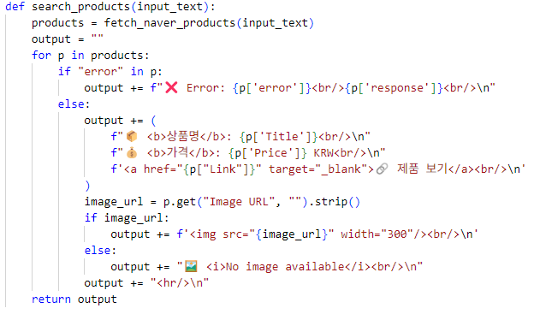
Naver API Integration
Code for Naver API Integration
Naver Product Search Function
8

Slide 10
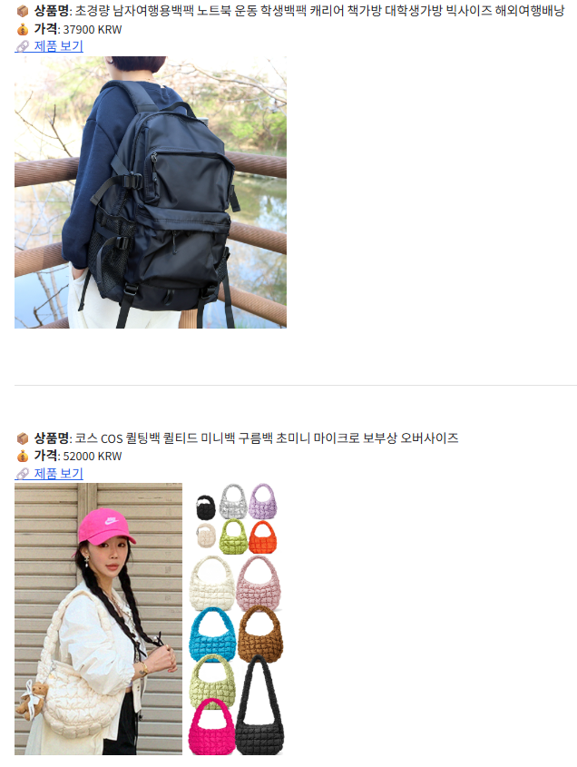
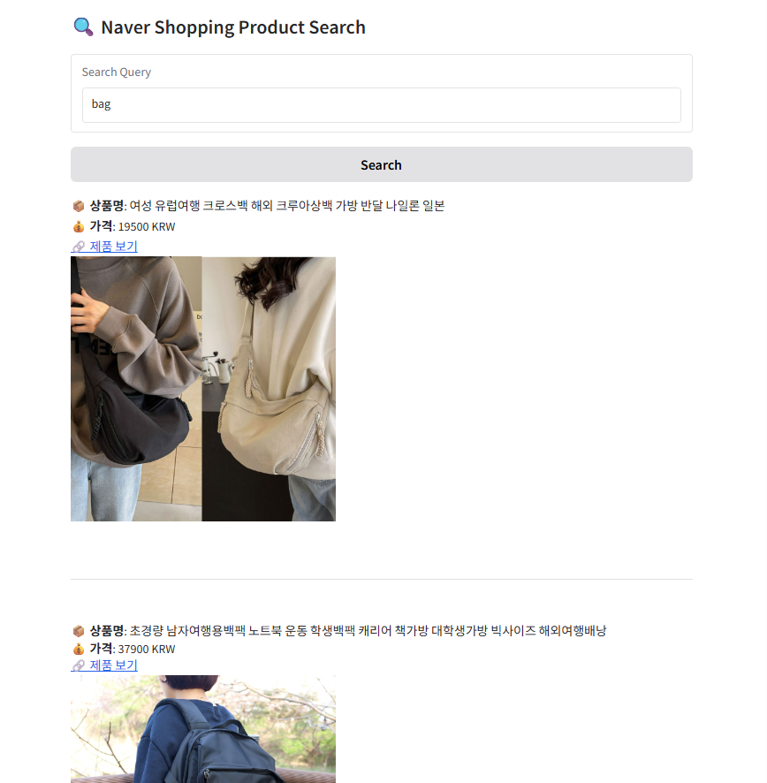
Naver Product Search: Simple Query
Simple query: bag
9

Slide 11
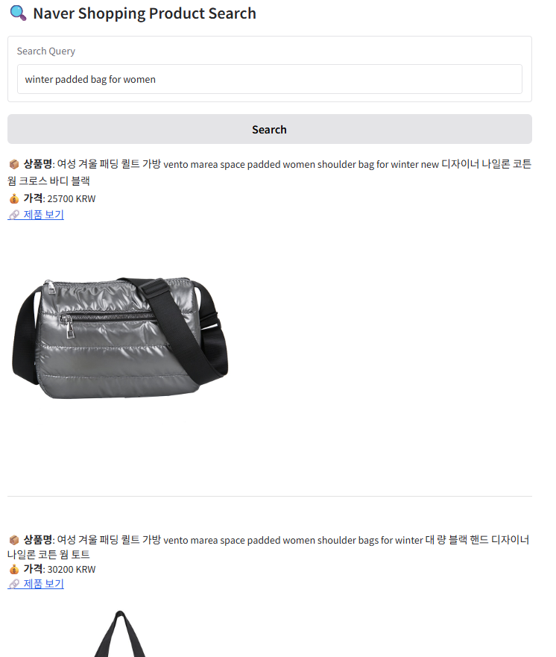
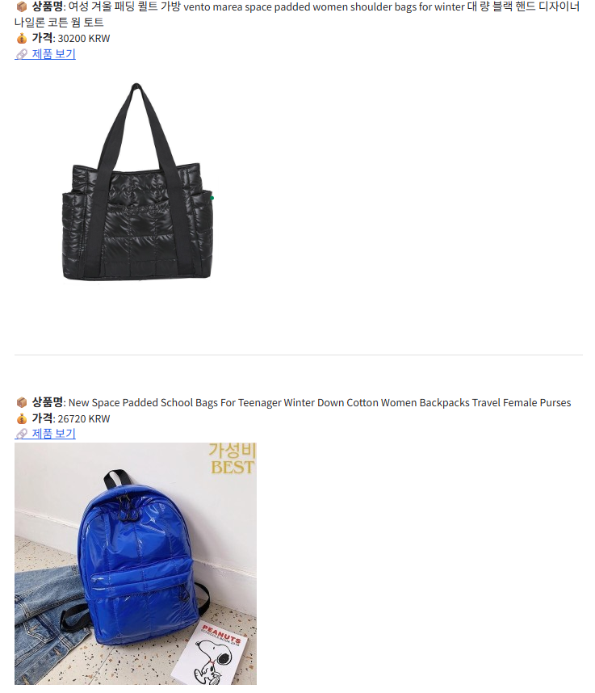
Naver Product Search: Complex Query
Complex query: winter padded bag for women
10

Slide 12
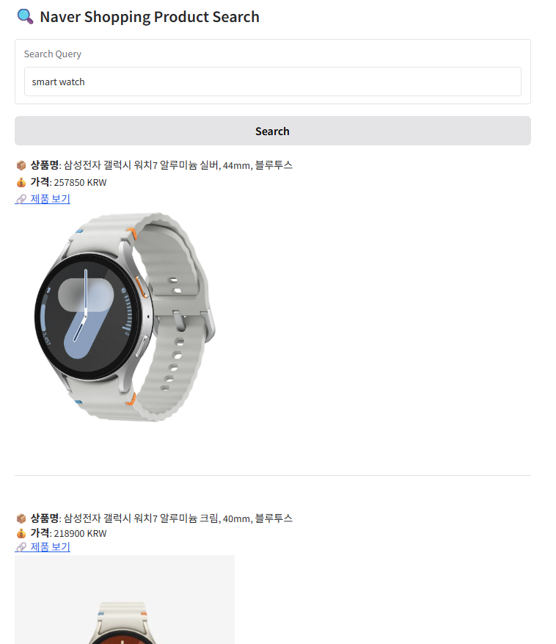
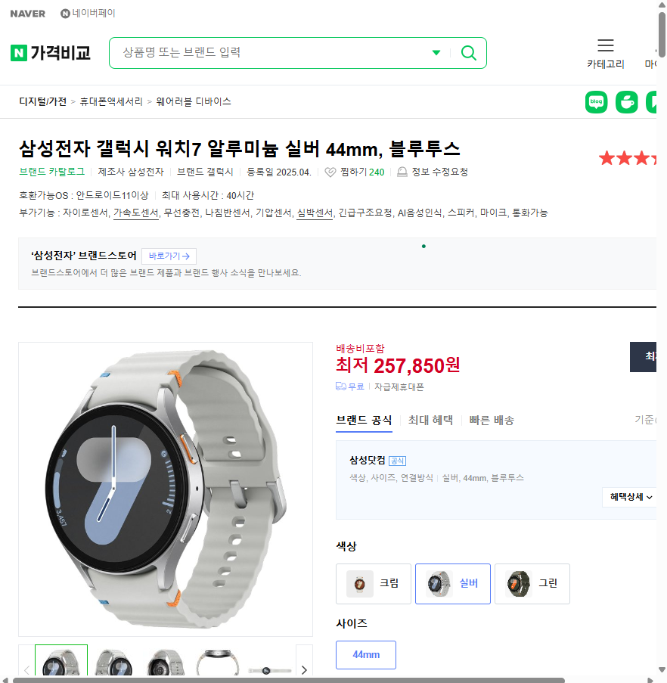
Naver Product Showing with Product Descriptions Link
Product Link
11

Slide 13
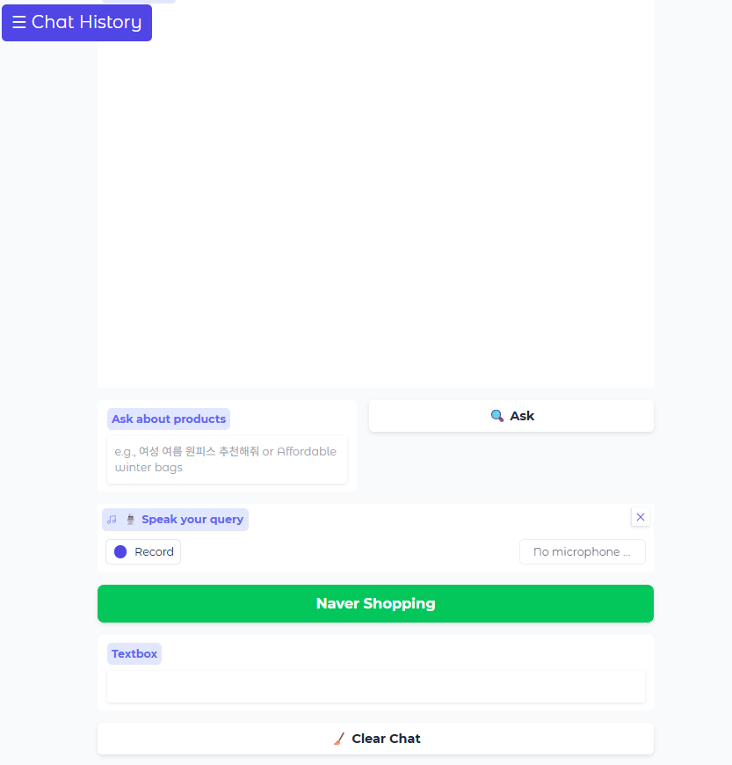
Incorporating a Dedicated Button in the Chatbot Interface
Dedicated button for Naver product Search.
Only for Naver Product Search (Shopping)
12

Slide 14
Incorporating Voice Input Button
Extra feature for voice input.
Voice Input
13

Slide 15
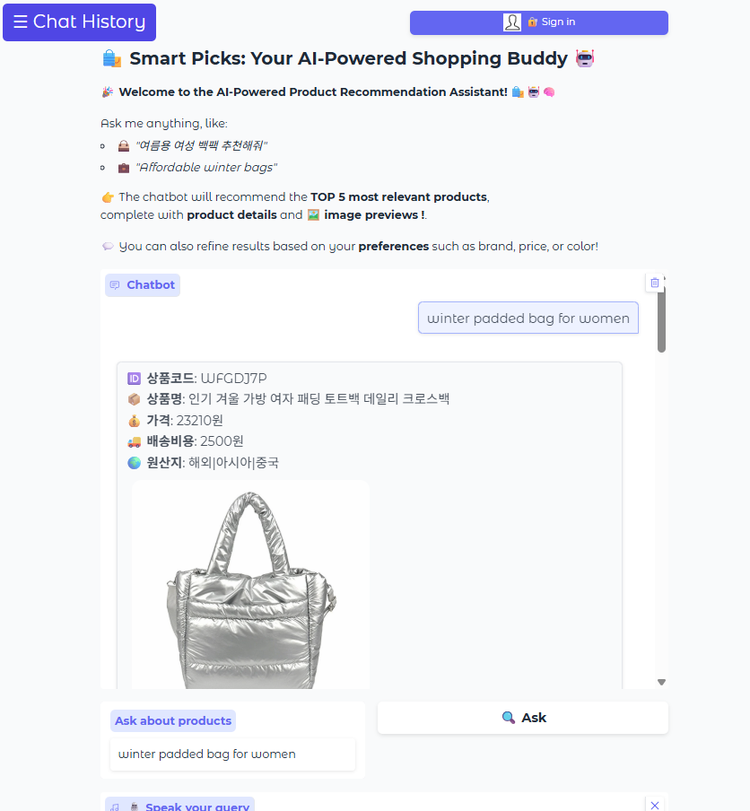
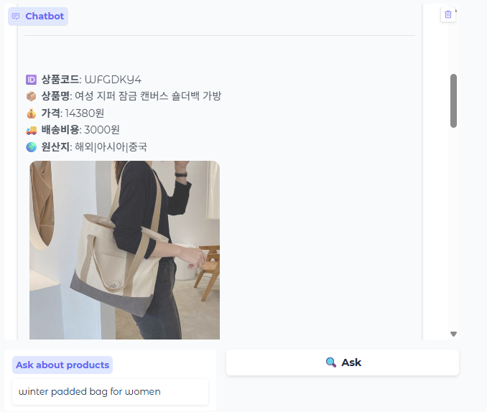
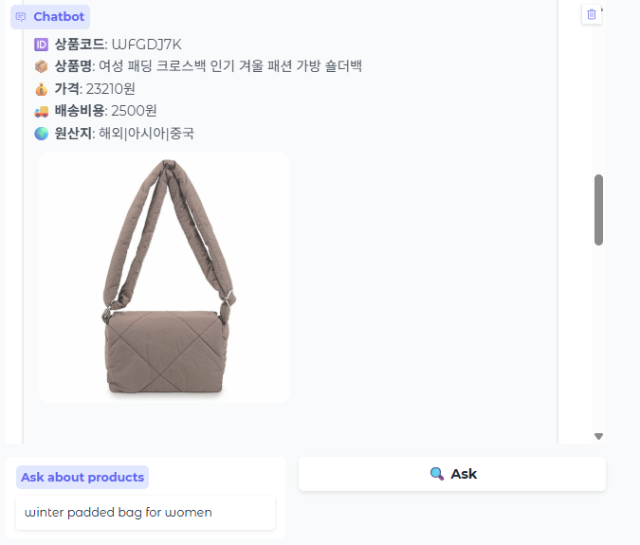
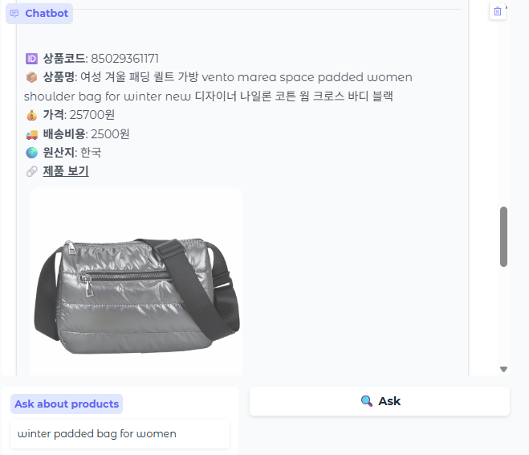
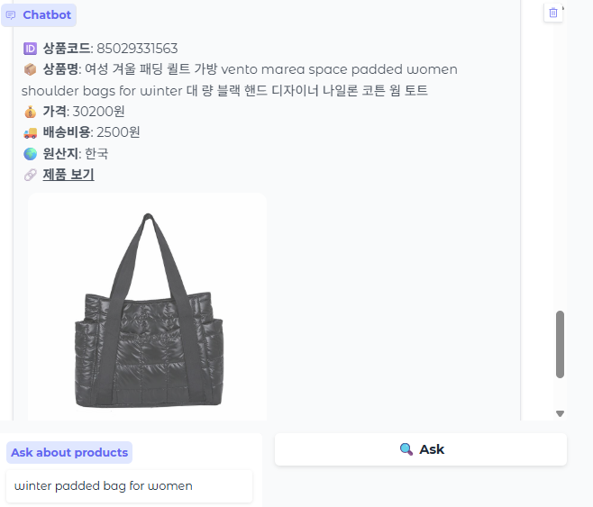
OwnerClan (3 Products) + Naver (2 Products)
Naver
Product
14

Slide 16
Next Tasks To Do
Next Step
Testing the system with simple, complex query.
Making a demo video.
15

Slide 17
Thank You for Listening.
16

